Slide 1




Data Science HACKATHON
TEAM 22
[Modeling air humidity for Farming using machine learning]
[THE GREENS]

Slide 2




[The Greens]
TEAM 22
Stancy J.K Bright
Faith Mutua
Abubakar Passum A. Gaffar
THE GREENS

Slide 3







[The Greens]
Outline
problem
Introduction
2
Statement
1
Data
3
4
Implications
findings
Solutions
5
6
Summary

Slide 4
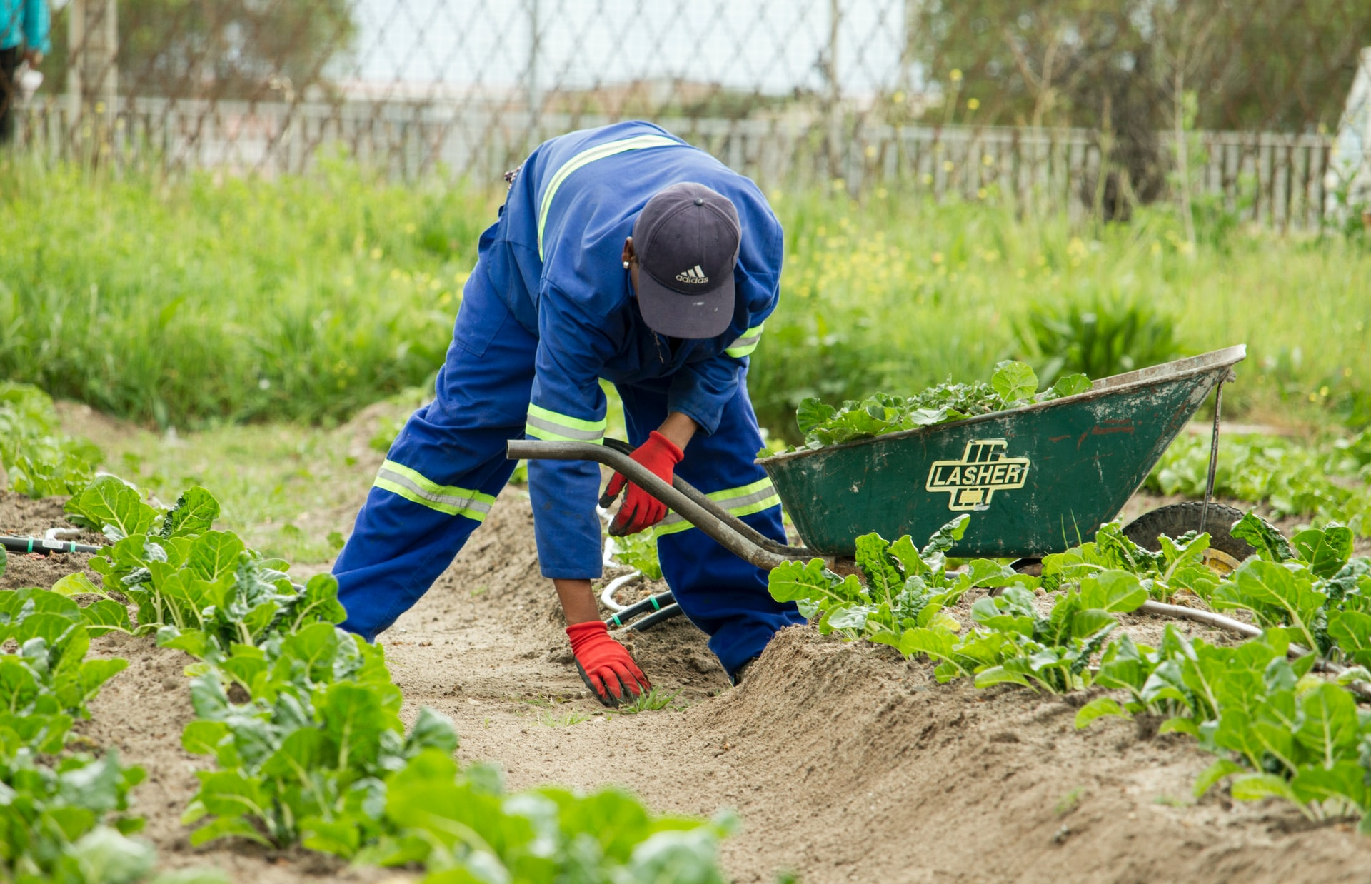
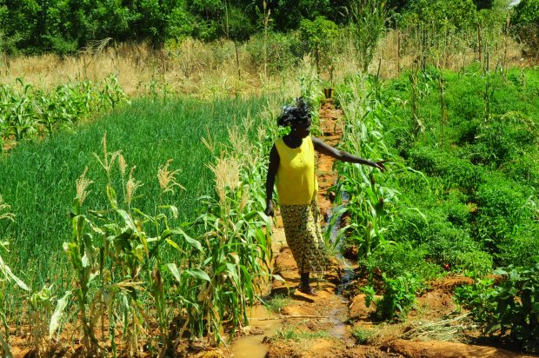
[The greens]
Introduction
Agriculture contributes to 54% of Ghana GDP at the same time providing over 90% of food needs of the country. (FAO)
Relative Humidity

Slide 5




[The GREENS]
Problem Statement
Climate change is likely to contribute substantially to food insecurity in the future by increasing food prices, and reducing food production
Crops
Climate
Change
Exposure to high humidity levels may lead to loss of crop quality due to occurrence and severity of fungal diseases, calcium and water deficiencies.
Economic
Market
The impact of high and low crop production on market consumption
impact

Slide 6


[The Greens]
Data Findings
Source
Parameters
Sunyani
Data
Eoric is a research arm of UENR, responsible for providing real time satellite-based data
Weather data recorded from 2017 to 2019. Temperature,RH,WS,WD,Water vapor,
dew, pressure, solar
Description
Correlation
Trending
Impact
Data
Insight

Slide 7
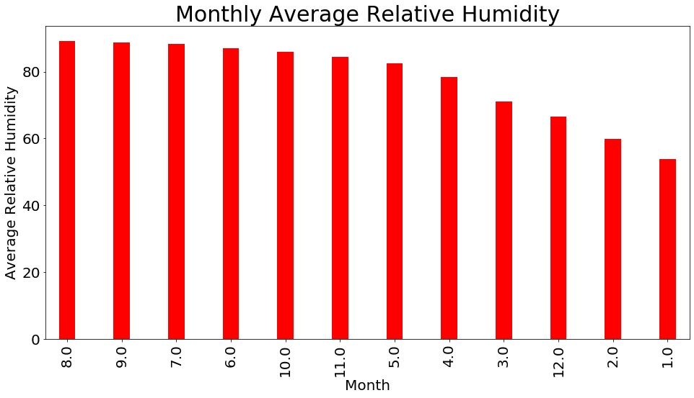
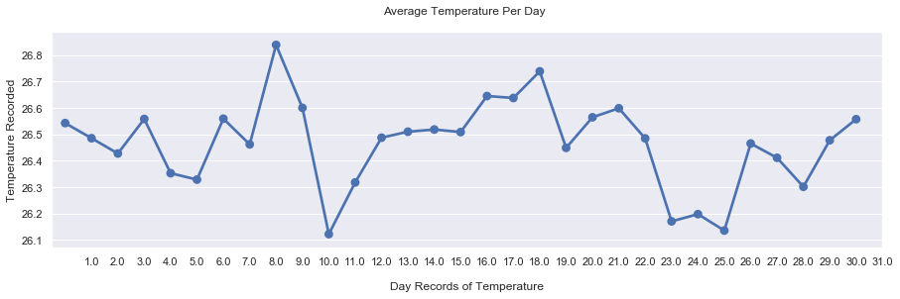
[The Greens]
Data Findings
The highest average RH was recorded in August and September with the lowest in January
The highest average Temperature was recorded on the 8th day of the month with the lowest on the 10th day.

Slide 8
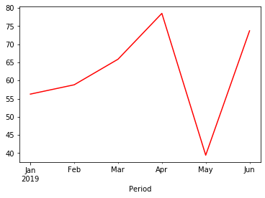
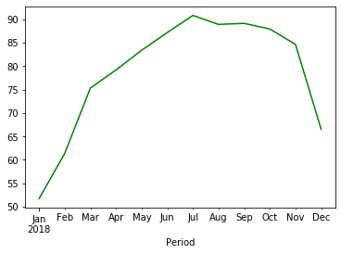
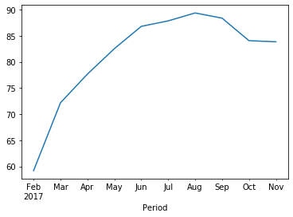
[NAME]
Data Findings
Detecting changes in weather pattern from 2017 to 2019.
A line plot of Resample Average RH in each Year.

Slide 9
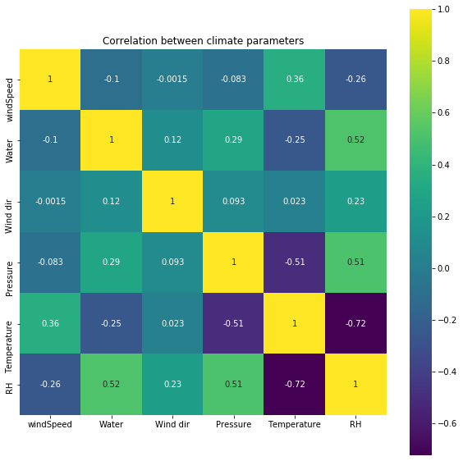
[NAME]
Data Findings
HeatMap
Heatmap to show the correlation between various parameters and the label (RH)

Slide 10
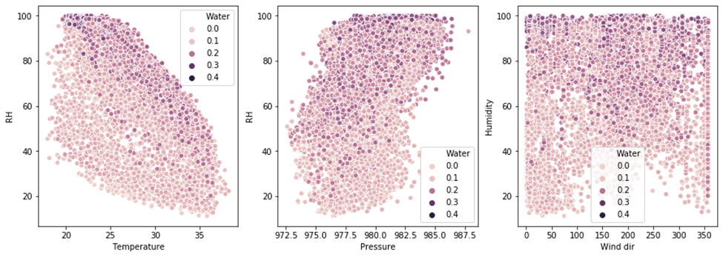
[NAME]
Data Findings
Scatter Plot
Temperature is highly correlated to RH (negative)
Pressure is positively correlated to RH

Slide 11
[NAME]
Implications
1
High Humidity
Low Humidity
2
Affect Crop quality
Plant water stress
Fungal Disease
Closure of Stomata
Pollination
Quality of crops
Photosynthesis
Photosynthesis
Calcium deficiency

Slide 12









[NAME]
Deep Dive on Solution
ML WORKFLOW
Prepare Data
Train Model
Validate Model
Deploy Model
Monitor Model
Regression
Time series forecasting
Openweather api

Slide 13
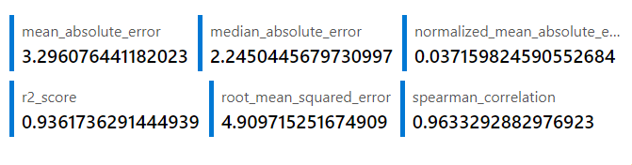
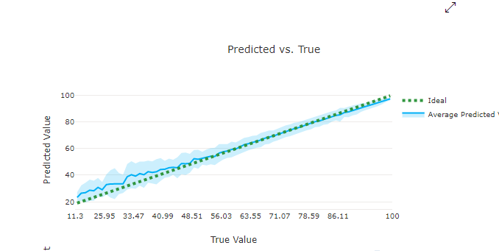
[NAME]
Deep Dive on Solution
LIGHTGBM
AZURE AUTOML

Slide 14
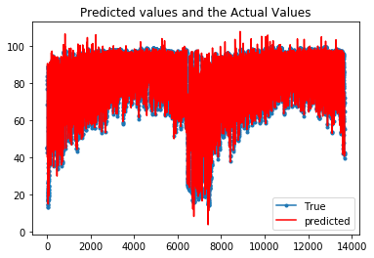
[NAME]
Deep Dive on Solution
LSTM
ROOT MEAN SQUARED ERROR
Train 3.11 RMSE
Test 3.11 RMSE

Slide 15

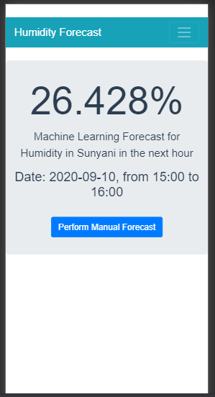

[NAME]
Deep Dive on Solution
Demonstration of the prototype
Web App
Mobile App

Slide 16
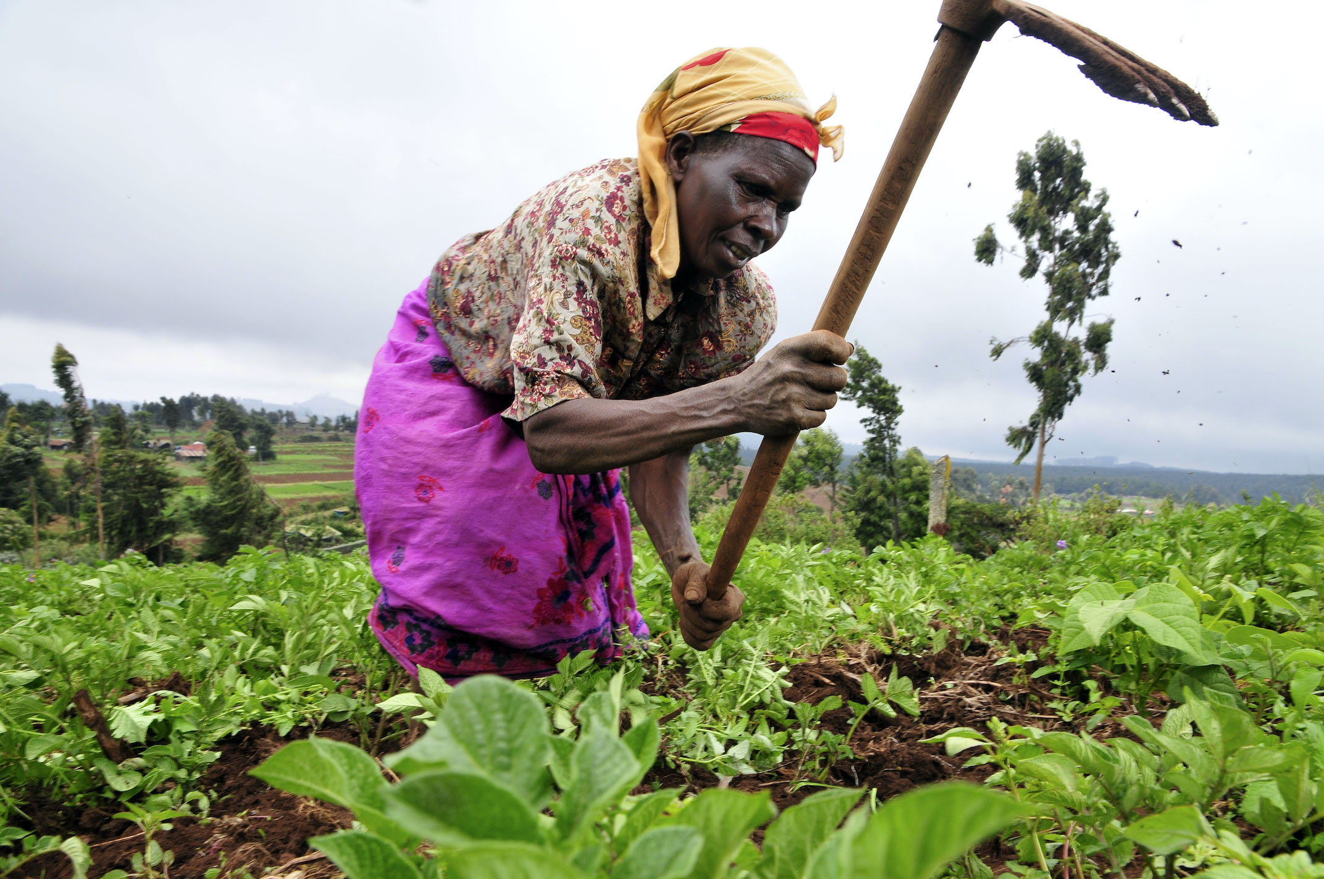
[NAME]
Summary
How it works
Pre-inform farmers about RH to make adjustments
Educate farmers on how to manage RH
Enable farmers to understand weather patterns
It can also be used in greenhouse to model microclimate parameters (RH).

Slide 17

[The Greens]
THANK YOU

